Slide 1
Smart Hotel Rooms
Akash Patil | Dheeraj RK | Pranav Bijapur | Tarun Verma

Slide 2
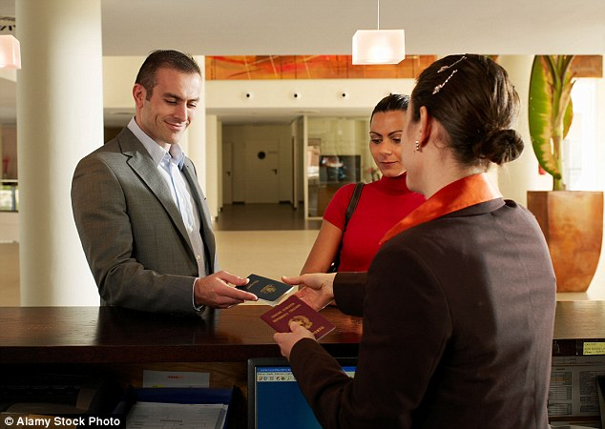
A General Hotel Check-In Mechanism
Image Source : Alamy Stock Photo

Slide 3
A General Hotel Check-In Mechanism
Guest enters the hotel, spots the reception and proceeds.
Enquires room for booking or shows receipt/proof of booking.
Verifies his/her identity by displaying a valid proof of identity.
Pays the amount or balance remaining.
Collects his key and enters his room.

Slide 4
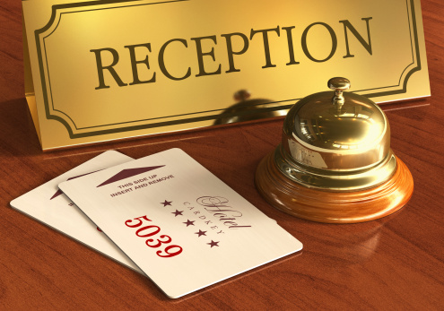
Liabilities of the present system
Image Source : Dreamstime Photo

Slide 5
Liabilities of the present system

Slide 6
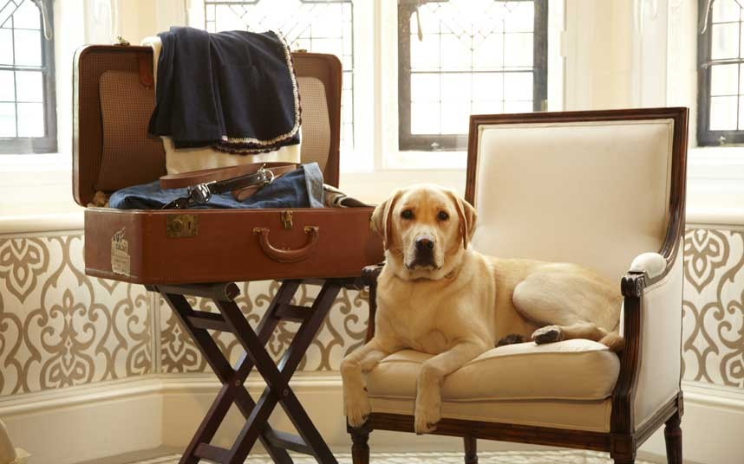
The Proposal
Image Source : Pinterest

Slide 7
The Proposal
Hotel rooms to be booked only using an online portal – web/app.
The portal verifies guest’s proof of identity using UID (India) or any other valid method.
After the payment, a unique QR code is generated.
At the time of check in, guest just have to enter the hotel and walk to his/her room. A scanner reads the QR code and lets you in.

Slide 8
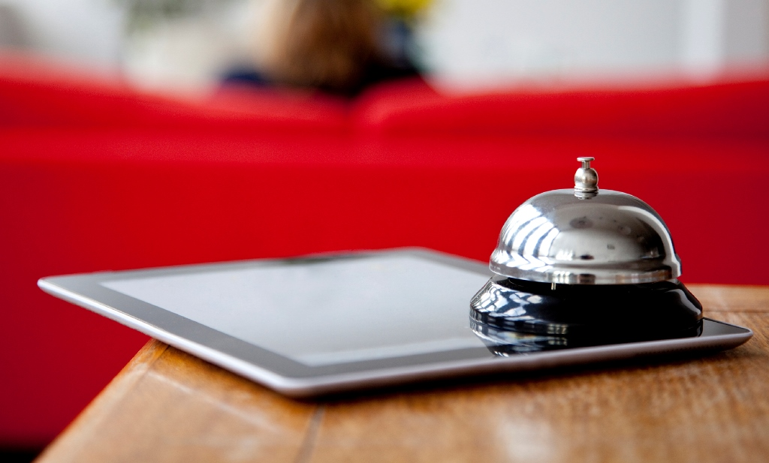
The Prototype
Image Source : Chiloe Austral Hostel

Slide 9
The Prototype
A web app is created that demonstrates hotel booking.
The web app demonstrates proof of concept for identity verification.
After booking, the web app generates a QR code – the key
A raspberry pi is programmed to scan QR code.
The board and the camera module acts as a device to demonstrate unlocking of door.

Slide 10
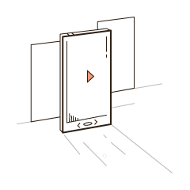
Demo Of The Prototype

Slide 11
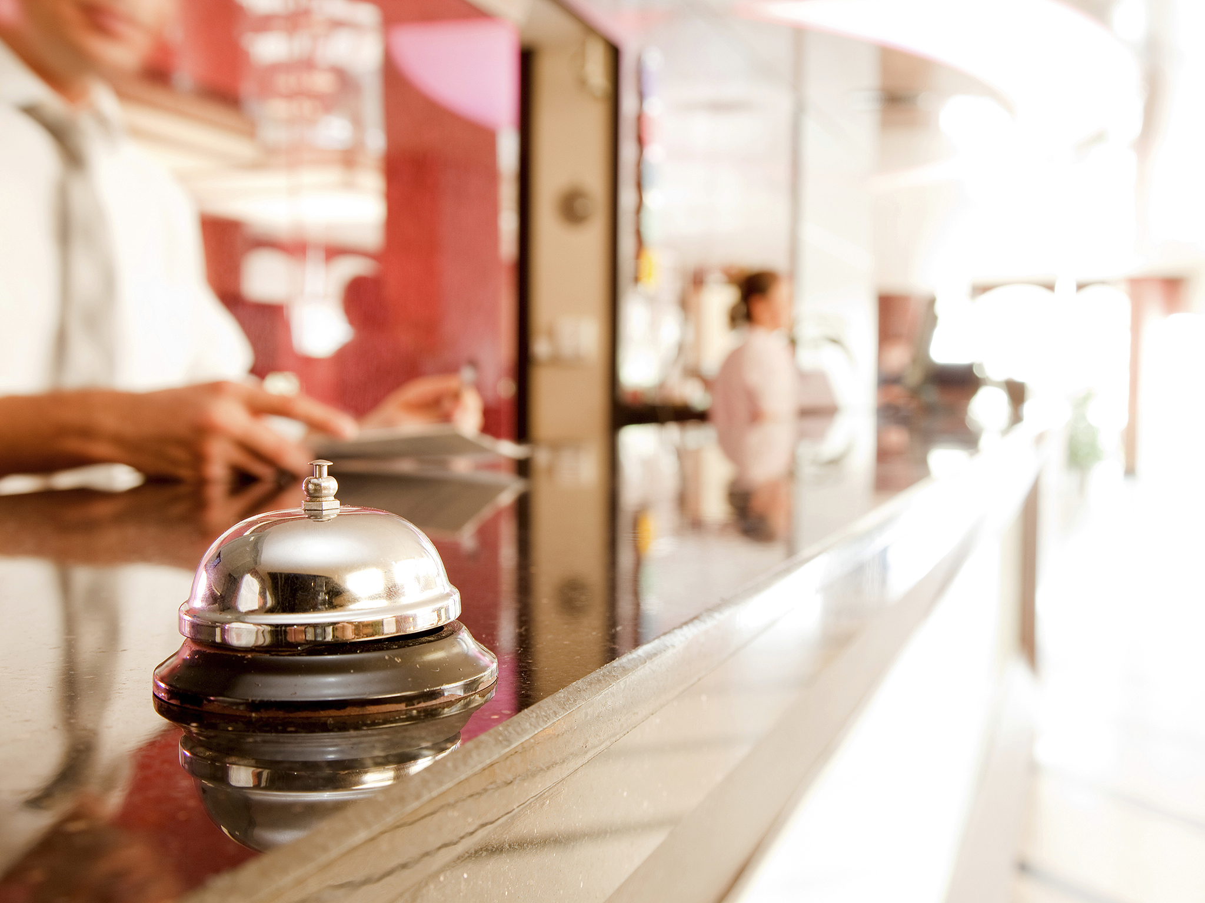
Economics Of The Idea
Image Source : Condé Nast

Slide 12
Economics Of The Idea

Slide 13
There's no such thing as 'normal'. That's just another word for lifeless. Shah Rukh Khan

Slide 14
Thank You !

